Slide 1

PersonaPundit.ai
Get to know insights about your consumers
By
Rucha Chotalia( NUID: 002711888)
Hardik Sodhani( NUID: 002770306)

Slide 2

What is a Persona?
In the current competitive market, understanding customer needs, preferences, and pain points is crucial for businesses to tailor their products and services effectively. Relying on manual analysis and synthesis of customer data, are often time-consuming and may not fully capture the nuanced and dynamic nature of customer behaviors and preferences. There is a need for automation in this segment to increase efficiency and to reduce manual workload. There is a critical need for an innovative solution that can swiftly and accurately process and analyze this extensive qualitative data to generate detailed and dynamic user personas.

Slide 3
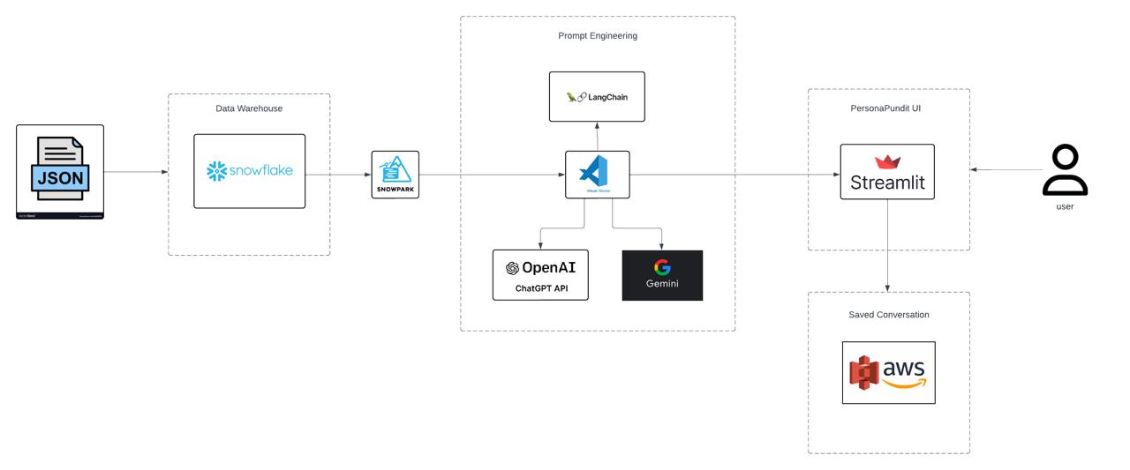
Architecture diagram

Slide 4




Insights from data source
Data Division Approach: Employing a systematic approach, the dataset will be divided into manageable chunks, consolidated into a structured table format for ease of analysis.
Data Cleaning Process: Rigorous data cleaning procedures will be implemented, removal of duplicates and standardization of formats, ensuring data integrity.
Data Source: Originating from 1998, the dataset is a valuable repository of historical data.
Curated Dataset: A meticulously curated dataset comprising 150 GB of data.

Slide 5
Features that will be included
Persona Generation using RAG:
Utilize RAG to create personas rich in context by querying Snowflake database for relevant data matching identified traits.
User Input Analysis:
LangChain analyzes user inputs to determine persona requirements.
Product Recommendation
Grouping personas and providing product recommendations based on preferences.
LLM Management:
Group Persona Generation:
LangChain facilitates communication with LLM, augmenting prompts with retrieved data and processing generated text.
Generate group personas and combined personas based on user preferences.
Notes:
Contextual Persona Generation using RAG: Leveraging RAG (Retrieval-Augmented Generation) technology enables the system to construct personas that are deeply contextualized and reflective of the user's characteristics. By querying the Snowflake database, LangChain identifies relevant data snippets matching the traits and attributes of the persona being generated. This approach ensures that the personas created are not only accurate but also resonate authentically with the user's profile.
User Input Analysis: LangChain's sophisticated algorithms analyze user inputs comprehensively. By employing natural language processing techniques, it discerns the nuances in user queries to determine the type of persona required. This initial analysis sets the stage for crafting personas that precisely meet the user's needs and preferences.
LLM Interaction Management: LangChain serves as the intermediary between the user and the Language Model (LLM), such as Gemini and Chat GPT 3.5. It orchestrates the interaction seamlessly, enhancing the user experience by augmenting prompts with relevant data retrieved from the database. Moreover, LangChain efficiently processes the text generated by the LLM, ensuring coherence and relevance in the conversation flow.
Multi-LLM Support: By integrating multiple LLM implementations like Gemini and Chat GPT 3.5, LangChain broadens the spectrum of persona generation capabilities. Each LLM brings its unique strengths and characteristics to the table, enriching the variety and depth of personas generated. This multi-LLM approach ensures flexibility and adaptability in catering to diverse user needs and preferences.
Group and Combined Persona Generation: LangChain goes beyond individual personas to generate group personas and combined personas. Group personas aggregate users with similar preferences or characteristics, facilitating collective insights and interactions. Combined personas merge distinct personas to create a holistic representation, accommodating users with diverse interests or roles.
Conversation Management: LangChain provides robust conversation management features, allowing users to save and revisit their chats effortlessly. The multi-chat functionality enables users to engage in multiple conversations simultaneously, enhancing productivity and convenience. Additionally, the system ensures data privacy and security throughout the conversation lifecycle.
Seamless Conversation Continuity: With LangChain, users experience uninterrupted conversation continuity across sessions and platforms. Whether switching devices or revisiting the conversation after a hiatus, users can seamlessly pick up where they left off. This seamless experience fosters deeper engagement and satisfaction among users, fostering long-term relationships with the platform.
User and Admin Login: LangChain prioritizes security and access control with user and admin login features. Users can create personalized accounts to access tailored services and preferences. Administrators, on the other hand, have privileged access to manage user accounts, monitor conversations, and configure system settings for optimal performance.
Customizable Chat Loading and Saving: LangChain empowers users with customizable options for loading and saving chats. Users can organize their conversations according to preferences, categorizing them by topic, date, or participants. This flexibility ensures that users can efficiently retrieve and reference past conversations as needed, enhancing productivity and knowledge retention.
Persona Grouping and Product Recommendations: LangChain leverages persona grouping to offer personalized product recommendations. By analyzing the collective preferences of grouped personas, the system can tailor recommendations that resonate with specific user segments. This targeted approach enhances user satisfaction and conversion rates, driving business growth and customer loyalty.

Slide 6
Week 1:
Snowflake data upload and Data preprocessing
Big data handling
LLM discovery
GPT 3.5 LLM integration
Persona generation
PROJECT TIMELINE
Week 2:
RAG with LangChain
Prompt engineering refinement
Group persona generation
GPT 3.5 integration
Gemini integration

Slide 7

Evaluating Project Performance
Key Metrics: Accuracy of persona generation, user engagement rates, and response times.
Calculation Methods: Use precision and recall for accuracy, session length for engagement, and average API response time for system responsiveness.
Initial Results: High accuracy in persona detail with some delays in response times during peak usage.
Observations: Positive user feedback on persona relevance, noting areas for speed optimization.

Slide 8

Methods to Improve Metrics
Machine Learning Optimizations: Integrate advanced model fine-tuning techniques to improve the efficiency and accuracy of the GPT-3.5 and Gemini LLMs.
Data Handling Enhancements: Implement better data indexing and query optimization in Snowflake to speed up data retrieval and processing.
Model Upgrades: Upgrade the LLM configurations to leverage the latest advancements in AI, ensuring more nuanced text analysis and persona generation.
Algorithm Enhancements: Apply newer, faster algorithms for data processing that reduce latency and improve throughput during high-demand periods.

Slide 9

Conclusion
PersonaPundit.ai seamlessly combines advanced AI technologies with practical business applications, transforming product review data into detailed user personas.
Utilizes OpenAI's GPT-3.5 and Gemini models, enhancing the depth and accuracy of customer insights.
Offers businesses enhanced customer understanding, facilitating targeted marketing and product development for improved satisfaction and success.

Slide 10
Future Scope
Integration with CRM Systems (e.g., Salesforce)
Workflow Automation with Workato
Ethical and Privacy Considerations

Slide 11

Thank you

Slide 12
Q&A

